Slide 1
CSP Provided Security Services
ACE Solutions Architecture Team
Notes:
The ACE-Security course and all the presentations are created or organized by Shahzad Ali Please reach out to provide feedback so we can improve it.

Slide 2
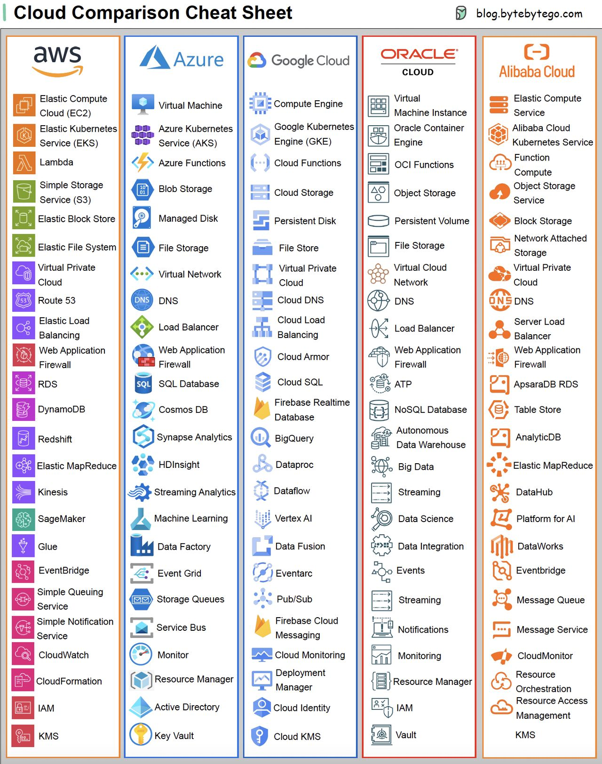
CSP Provided Security Services
All public cloud providers offer services with their own implementation techniques and pricing models.
Customer needs to stitch multiple services together
Security design in each cloud will be different.
Customer demands consistency, clean design and simple operation
The “Shared Responsibility” is Customer’s Responsibility at the end
References
https://aws.amazon.com/blogs/security/update-of-aws-security-reference-architecture-is-now-available/
https://azure.microsoft.com/en-us/solutions/network-security https://aviatrix.com/resources/aviatrix/security-is-up-to-you-when-it-comes-to-cloud-security-don-t-rely-on-your-csp
https://cloud.google.com/docs/get-started/aws-azure-gcp-service-comparison

Slide 3
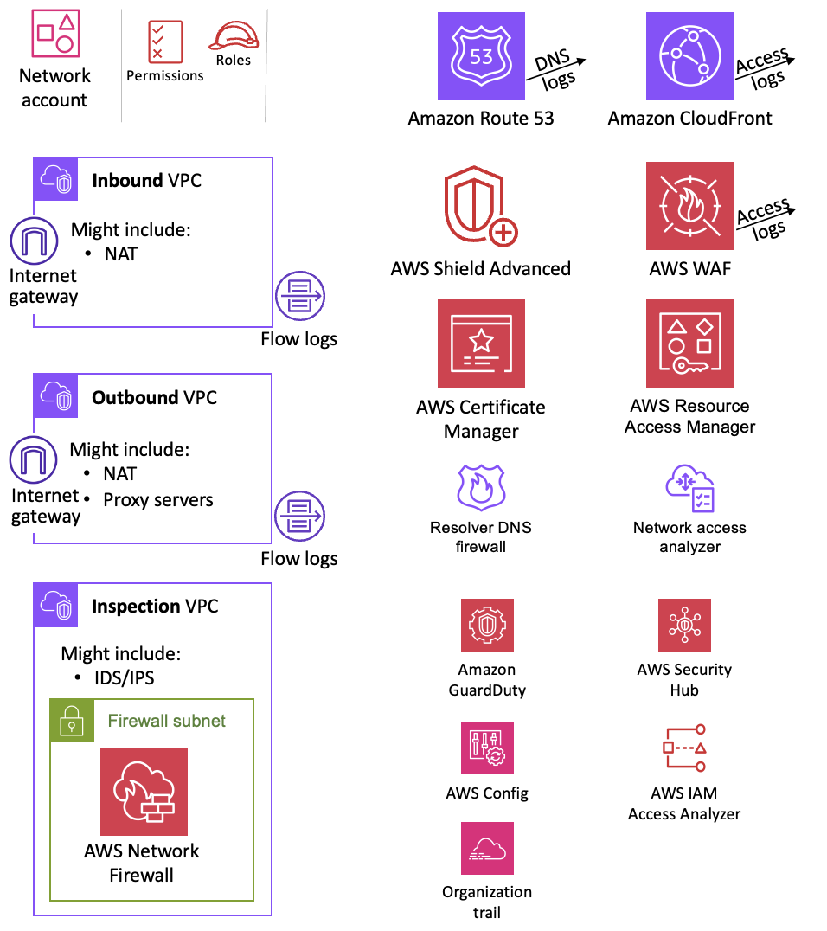
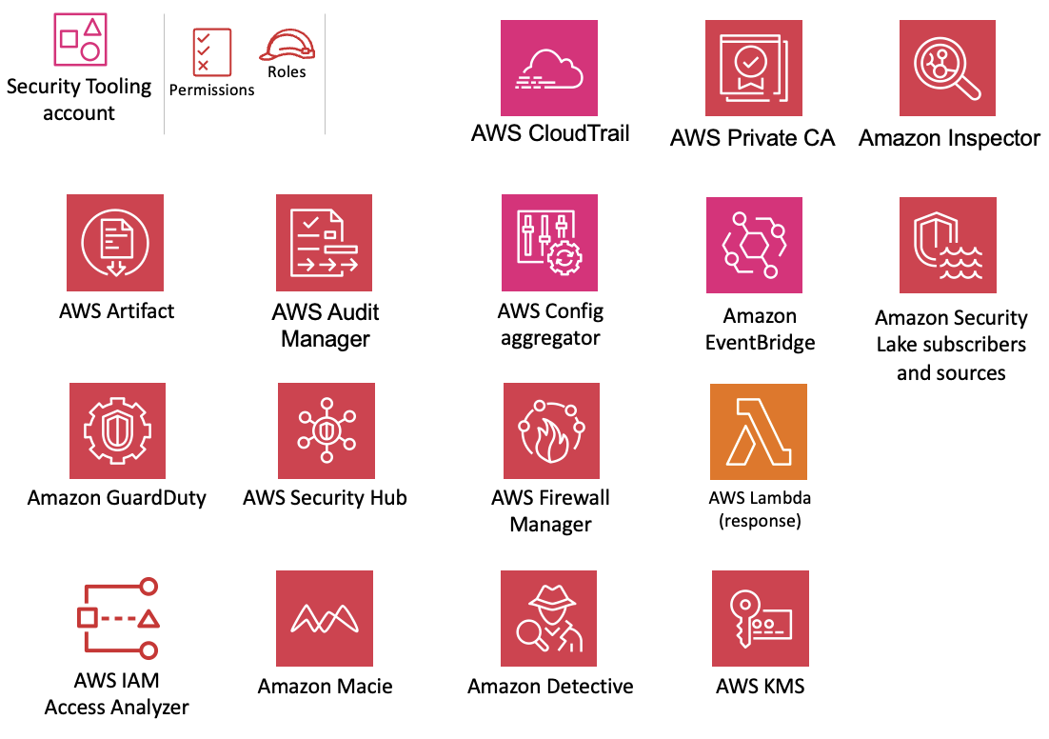
Design and deploy security in single cloud is a challenge
* Don’t underestimate the cost implications

Slide 4
Design and deploy security in multiple clouds is even more challenging
Use-Case(s) | AWS Service | Azure Service
Users to control access to services and resources | Identity and Access Management (IAM) | Azure Active Directory
Protect Internet-facing web applications from common exploits. | Web Application Firewall | Web Application Firewall
Ingress and Egress Firewall for web and non-web traffic East/West and North/South Firewall for web and non-web traffic | AWS Network Firewall | Firewall
Detect threats from on-premises and in the cloud locations. | GuardDuty | Microsoft Sentinel
Protection from distributed denial of services (DDoS) attacks. | Shield | DDos Protection Service
L4 Security to allow or block traffic going to EC2/VM | Security Group | Network Security Group
* Don’t underestimate the cost implications
* Due to time constraints, we only discussed AWS and Azure. Other public clouds also offer similar services.

Slide 5
Design and Deploy Security in Multiple Clouds Could be Worse
Use-Case(s) | AWS Service | Azure Service
Normalize and correlate network data for analysis of risky activity. | Amazon Security Lake | Azure Sentinel
On-prem connectivity with security | Direct Connect MACSec | Express Route with MACSec
Logging and Monitoring | CloudWatch, Cloud Trail, VPC Flow Logs, AWS Network Manager | Azure Monitor, Network Watcher
Aggregates security alerts from CSP and partner products | AWS Security Hub | Azure Security Center Microsoft Defender for Cloud
IPSec Encryption for Network Data in Transit | S2S VPN with VGW | S2S VPN with VNG
Network Segmentation (VRF) | Manual route table management | Manual UDR management
* Don’t underestimate the cost implications
* Due to time constraints, we can only discuss AWS and Azure. Other public clouds also offer similar services.

Slide 6
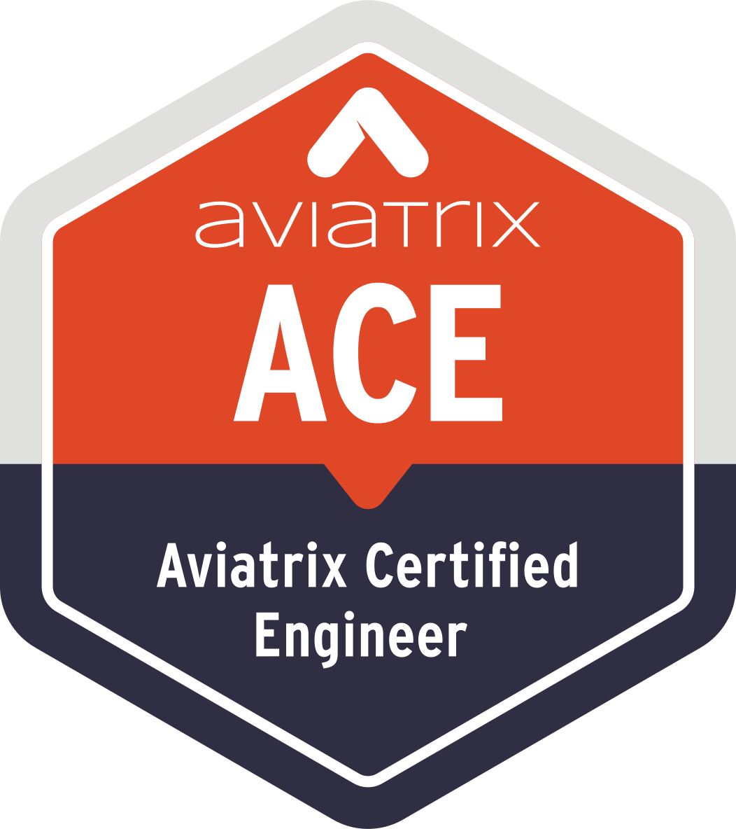

Aviatrix Certified Engineer (ACE)
COMMUNITY
https://aviatrix.com/ACE
https://community.aviatrix.com

Slide 8
Summary
Key Aviatrix Security Features
Encryption
Standard
High Performance
Centralized Firewall
Inside the Cloud
On-Prem
Aviatrix FireNet
East-West
Ingress/Egress
Distributed Cloud Firewall
Egress
Ingress
Public Subnet Filtering
GuardDuty
Threat IQ and Threat Guard
Advanced NAT
FQDN/URL Filtering
ThreatIQ and Threat Guard
Geo-Fencing
Geo-Fencing
East/West North/South
Network Segmentation
Micro-Segmentation
L7 Firewall
Anomaly Detection (Shahzad to fix this)
L7 Firewall
L7 Firewall

Slide 9



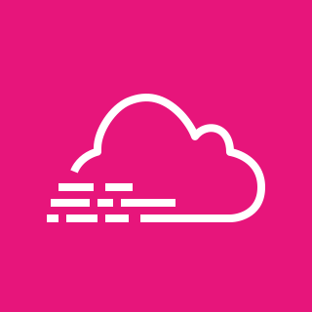









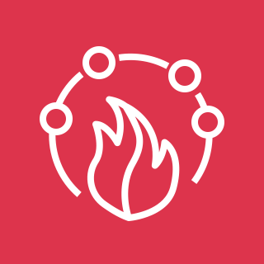
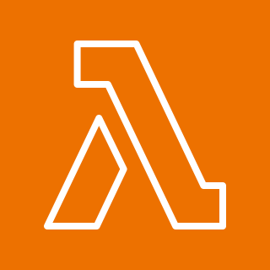
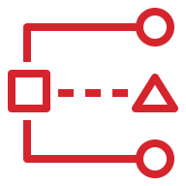



Security Tooling
account
Permissions
Roles
AWS CloudTrail
AWS Private CA
Amazon Inspector
AWS Artifact
AWS Audit Manager
AWS Config
aggregator
Amazon EventBridge
Amazon Security Lake subscribers and sources
Amazon GuardDuty
AWS Security Hub
AWS Firewall Manager
AWS Lambda
(response)
AWS IAM
Access Analyzer
Amazon Macie
Amazon Detective
AWS KMS

Slide 10









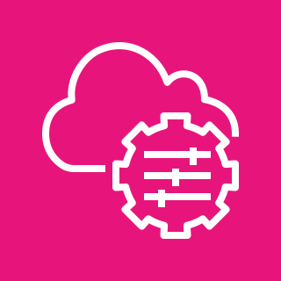
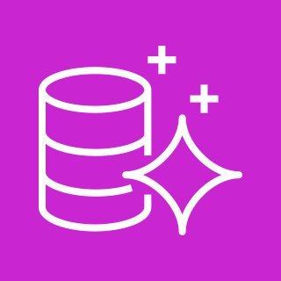


OU – Workloads
Permissions
Roles
Application
account
AWS Security Hub
Amazon S3 data bucket
AWS Secrets
Manager
AWS KMS
VPC
Amazon GuardDuty
Private subnet
Application
Load Balancer
Amazon KMS endpoint
AWS Private CA
AWS Config
EC2 instances
Systems Manager endpoint
Amazon Macie
Private subnet
AWS CloudHSM
Amazon S3
endpoint
AWS IAM
Access Analyzer
Amazon Aurora
AWS Systems
Manager Agent
Flow logs
Amazon Cognito
Organization trail

Slide 11



OU – Infrastructure
Permissions
Roles
Shared Services
account
AWS IAM Identity Center (delegated)
AWS Systems
Manager
AWS Directory
Service
AWS Managed
Microsoft AD
AWS Security Hub
Amazon
GuardDuty
Amazon Macie
AWS Config
AWS IAM
Access Analyzer
Organization trail

Slide 12

OU – Security
Central logs
Permissions
Roles
Log Archive
account
Amazon Security Lake
From CloudTrail organization trail
Access
logs
DNS
logs
Flow logs
AWS Security Hub
Amazon
GuardDuty
Amazon Macie
AWS Config
AWS IAM
Access Analyzer
Organization trail

Slide 13
AWS Security Groups vs Azure NSG
Name | Design Considerations | Cost Considerations
AWS Security Group (SG) | Security Group limits Security Group manual management | None
Azure Network Security Group (NSG) | Security Group limits Security Group manual management | None

Slide 14
AWS Network Firewall vs Azure Firewall
Name | Design Considerations | Cost Considerations
AWS Network Firewall | Manual efforts required for service chaining. Deep understanding of Suricata required for policy | Cost of AWS TGW attachment and data processing charges
Azure Firewall
3rd Party Firewall (Palo Alto, Checkpoint, Fortinet, etc.) | Centralized Mode adds latency and cost due to Egress traffic. Manual routing updates are required in VPC or VNET to route the traffic to centralized VPC/VNET. | Egress traffic cost Attachment cost

Slide 15
End-to-End IPSec Encryption for Data in Motion
Name | Design Considerations | Cost Considerations
AWS S2S VPN with VGW | 1.25 Gbps limit | Data processing charges
Azure S2S VPN with VNG | 1.25 Gbps limit | Data processing charges
AWS Direct Connect | 1.25 Gbps limit | Egress is costly with data processing charges. Unused bandwidth
Azure Express Route | 1.25 Gbps limit | Egress is costly with data processing charges. Unused bandwidth
AWS VPC Peering | Encryption details not known provided by CSP fabric | None
Azure VNET Peering | Encryption details not known provided by CSP fabric | None

